Slide 1

AgriPredict: ML-Driven Insights for Data-Driven Crop Production, Yield Forecasting, and Risk Mitigation

Slide 2
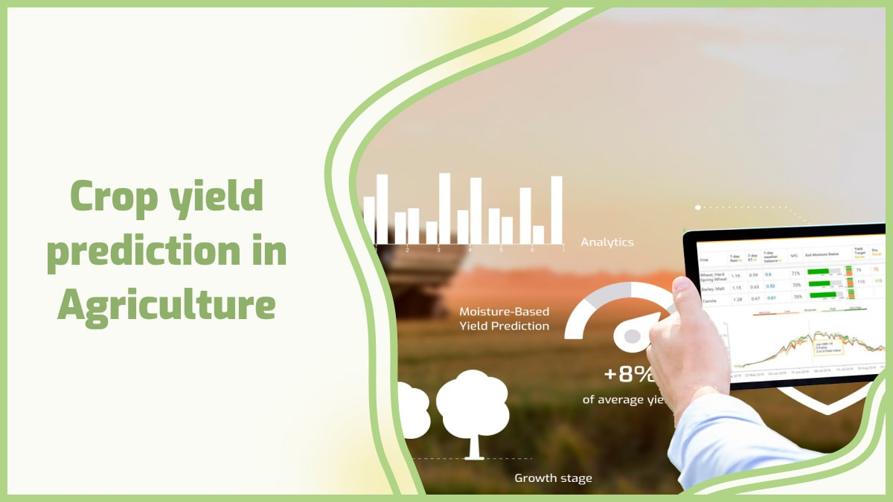
GROUP NUMBER 13
Magdum Rutuja (250243025018)
Patil Gayatri (250243025022)
Sahu Rachna (25024302526)
Mahajan Shraddha (250243025056)
Guided By: Milind Kapse Sir
AgriPredict

Slide 3
Problem Statement
The Indian agricultural sector, a cornerstone of the nation's economy, faces significant challenges from unpredictable weather patterns, particularly rainfall variability. Accurately predicting crop production is crucial for national food security, economic stability, and effective policy-making. This project aims to build a predictive model that forecasts crop production and select best crop for cultivation based on a combination of factors, including rainfall, season, crop type, and area under cultivation. The goal is to provide a reliable tool for stakeholders to make informed decisions .

Slide 4
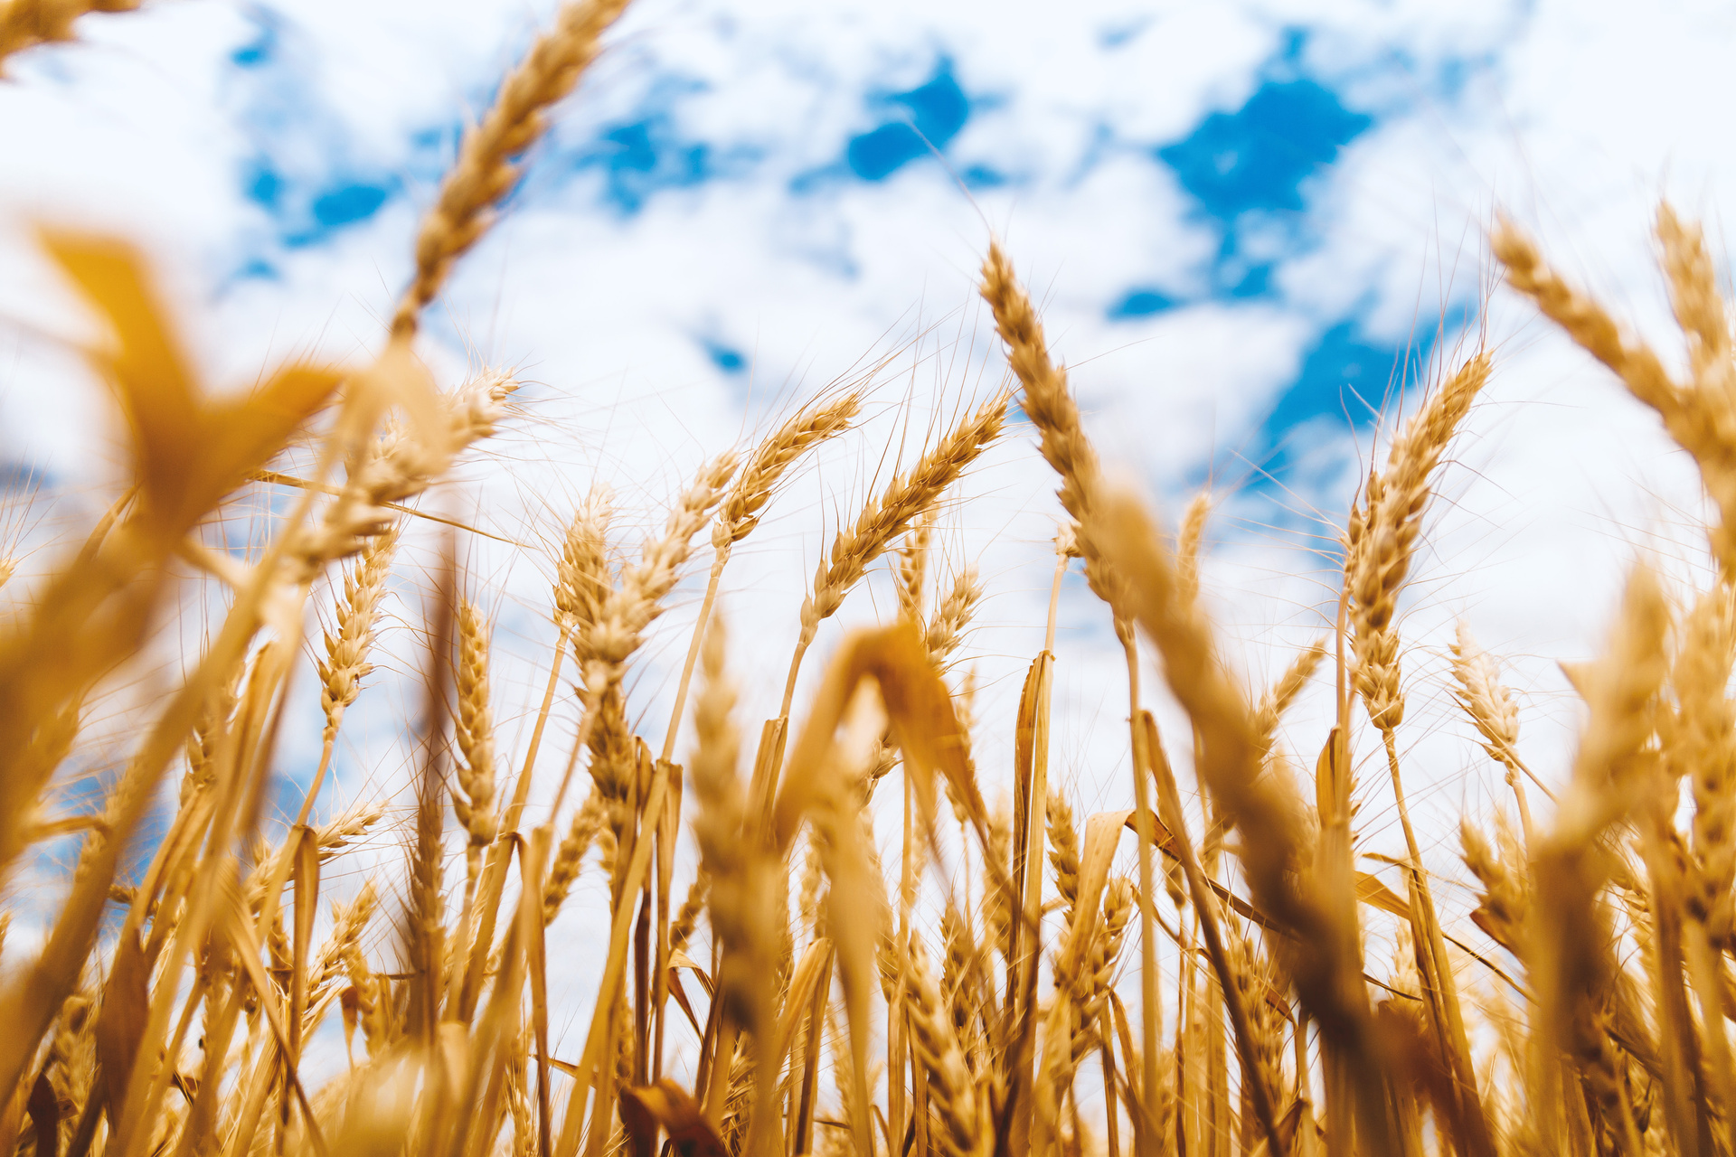
Introduction
AgriPredict develops an intelligent agricultural analytics system using machine learning and big data technologies to optimize crop production & selection strategies across India.
We employ PySpark for distributed data pre-processing of historical agricultural records. Our machine learning pipeline incorporates regression models for production prediction, classification algorithms for crop recommendation.
The system identifies regional production patterns, seasonal variations, and optimal cultivation practices through comprehensive feature engineering and model evaluation. Analytical results are visualized through interactive Tableau dashboards and User Interface, providing actionable insights for farmers and agricultural policymakers.
This end-to-end solution demonstrates how big data technologies and machine learning can enhance agricultural productivity through data-driven decision making.

Slide 5
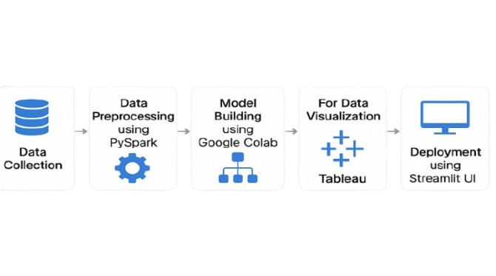
Flow Diagram

Slide 6


Data Set
Name of dataset : Agriculture Crop Production In India
we have taken our dataset from Kaggle.
(https://www.kaggle.com/datasets/asishpandey/crop-production-in-india?select=Data_after_rainfall.csv)
The Data Set consist of 4 tables which have been merged together to form a single table
with features related to crop type , rainfall ,temperature conditions & fertilizer information.

Slide 7

Data preparation and processing
For data pre-processing we have used Apache PySpark.
We have followed following steps :
Data Merging
Missing value imputation
Drop duplicates
Drop unnecessary columns
Feature engineering
Outlier Detection & Imputation

Slide 8
Light GBM
XGBoost
Data Models
A fast, high-performance gradient boosting framework using less memory.
Employed for its high performance and speed in handling large datasets with boosting techniques.
Neural Network
Employed for its ability to automatically learn complex patterns and features from raw data, making it a powerful tool for a wide range of tasks .
Logistic Regression
CatBoost
Leveraged use of symmetric trees to create highly accurate and stable regression models with minimal tuning.
Employed for its simplicity, speed, and interpretability in solving binary classification problems.

Slide 9
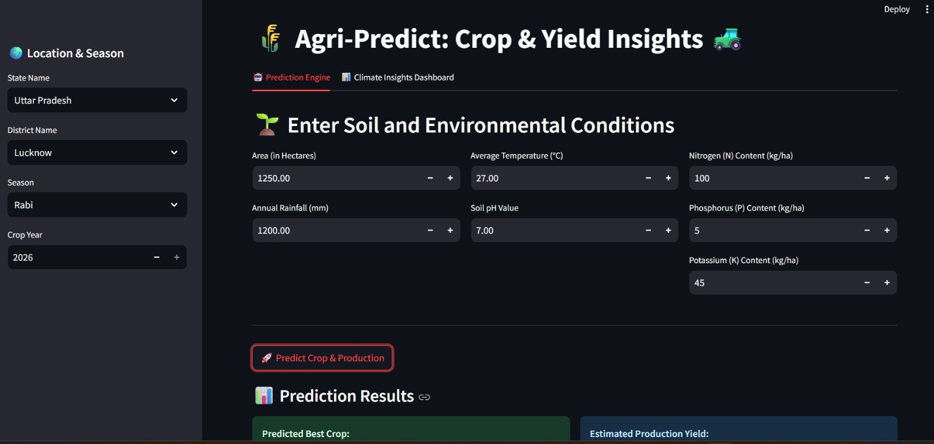
User Interface
using STREAMLIT

Slide 10
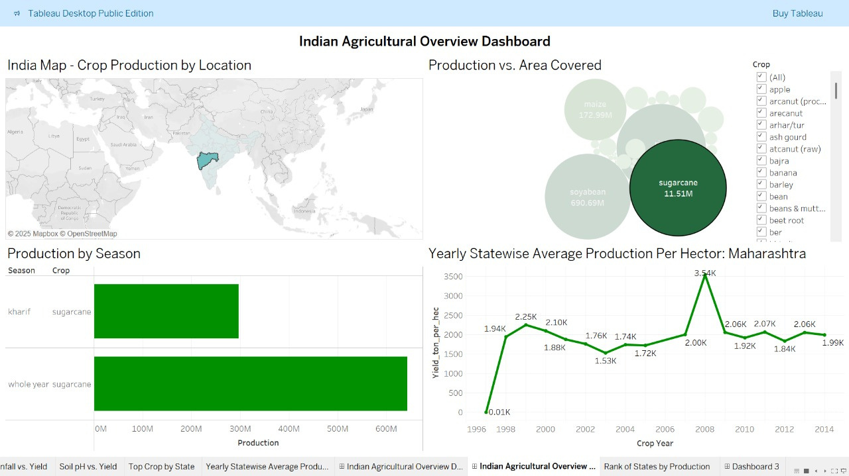
DASHBOARD

Slide 11
Conclusion
•The XGBoost & LightGBM model demonstrated strong performance in Predicting Production & Crop achieving an R2 score of 84% and accuracy of 86% respectively.
•The combination of robust data preprocessing, effective feature selection, and hyperparameter tuning contributed to the model's success.
•The insights gained from the analysis can help stakeholders make informed decisions and mitigate risk.
Future scope
•Early Warning System: Create an alert system that can notify stakeholders about potential crop failures or surpluses based on real-time climate data.
•Economic and Market Data: Integrate data on fertilizer prices, seed costs, market demand, and historical crop prices to understand the economic drivers of production.

Slide 12
thank
you

